Slide 1
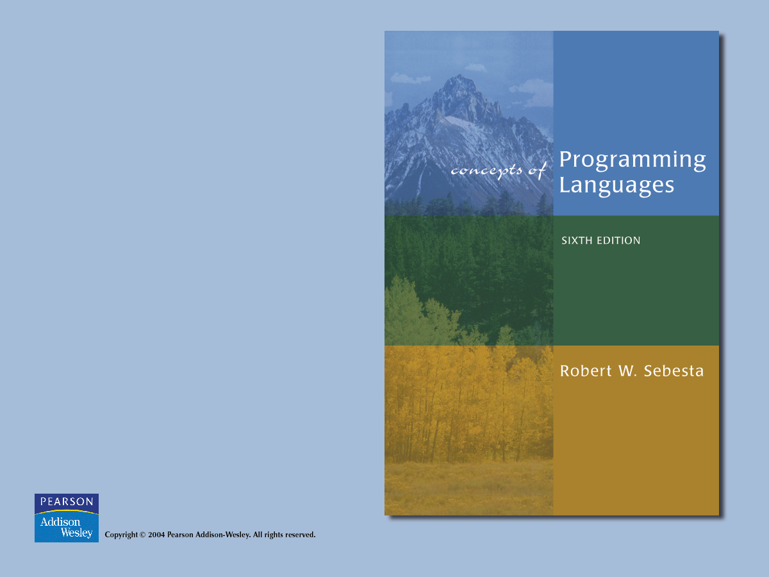
Chapter 2
Evolution of the Major Programming Languages

Slide 2

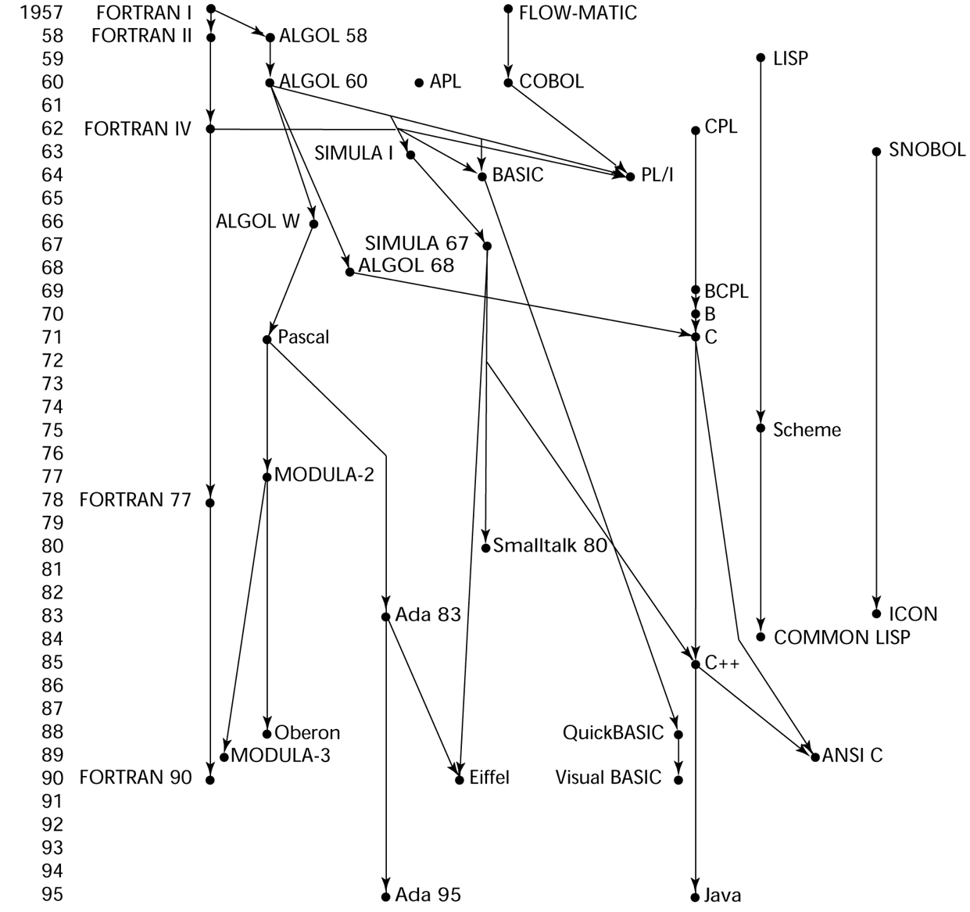
Genealogy of Common Languages

Slide 3
Zuse’s Plankalkül - 1945
Never implemented
Advanced data structures
  floating point, arrays, records
Invariants

Slide 4
Plankalkül
Notation:
A[7] = 5 * B[6]
| 5 * B => A
V | 6 7 (subscripts)
S | 1.n 1.n (data types)

Slide 5
Pseudocodes - 1949
What was wrong with using machine code?
  Poor readability
  Poor modifiability
  Expression coding was tedious
  Machine deficiencies--no indexing or floating point

Slide 6
Pseudocodes
Short code; 1949; BINAC; Mauchly
  Expressions were coded, left to right
  Some operations:
1n => (n+2)nd power
2n => (n+2)nd root
07 => addition

Slide 7
Pseudocodes
Speedcoding; 1954; IBM 701, Backus
  Pseudo ops for arithmetic and math functions
  Conditional and unconditional branching
  Autoincrement registers for array access
  Slow!
  Only 700 words left for user program

Slide 8
Pseudocodes
Laning and Zierler System - 1953
  Implemented on the MIT Whirlwind computer
  First "algebraic" compiler system
  Subscripted variables, function calls, expression translation
  Never ported to any other machine

Slide 9
IBM 704 and FORTRAN
FORTRAN I - 1957
(FORTRAN 0 - 1954 - not implemented)
  Designed for the new IBM 704, which had index registers and floating point hardware
  Environment of development:
    Computers were small and unreliable
    Applications were scientific
    No programming methodology or tools
    Machine efficiency was most important

Slide 10
IBM 704 and FORTRAN
Impact of environment on design of FORTRAN I
  No need for dynamic storage
  Need good array handling and counting loops
  No string handling, decimal arithmetic, or powerful input/output (commercial stuff)

Slide 11
IBM 704 and FORTRAN
First implemented version of FORTRAN
  Names could have up to six characters
  Post-test counting loop (DO)
  Formatted I/O
  User-defined subprograms
  Three-way selection statement (arithmetic IF)
  No data typing statements

Slide 12
IBM 704 and FORTRAN
First implemented version of FORTRAN
  No separate compilation
  Compiler released in April 1957, after 18 worker-years of effort
  Programs larger than 400 lines rarely compiled correctly, mainly due to poor reliability of the 704
  Code was very fast
  Quickly became widely used

Slide 13
IBM 704 and FORTRAN
FORTRAN II - 1958
  Independent compilation
  Fix the bugs

Slide 14
IBM 704 and FORTRAN
FORTRAN IV - 1960-62
  Explicit type declarations
  Logical selection statement
  Subprogram names could be parameters
  ANSI standard in 1966

Slide 15
IBM 704 and FORTRAN
FORTRAN 77 - 1978
  Character string handling
  Logical loop control statement
  IF-THEN-ELSE statement

Slide 16
IBM 704 and FORTRAN
FORTRAN 90 - 1990
  Modules
  Dynamic arrays
  Pointers
  Recursion
  CASE statement
  Parameter type checking

Slide 17
IBM 704 and FORTRAN
FORTRAN Evaluation
  Dramatically changed forever the way computers are used

Slide 18
LISP - 1959
LISt Processing language
(Designed at MIT by McCarthy)
AI research needed a language that:
  Process data in lists (rather than arrays)
  Symbolic computation (rather than numeric)
Only two data types: atoms and lists
Syntax is based on lambda calculus

Slide 19
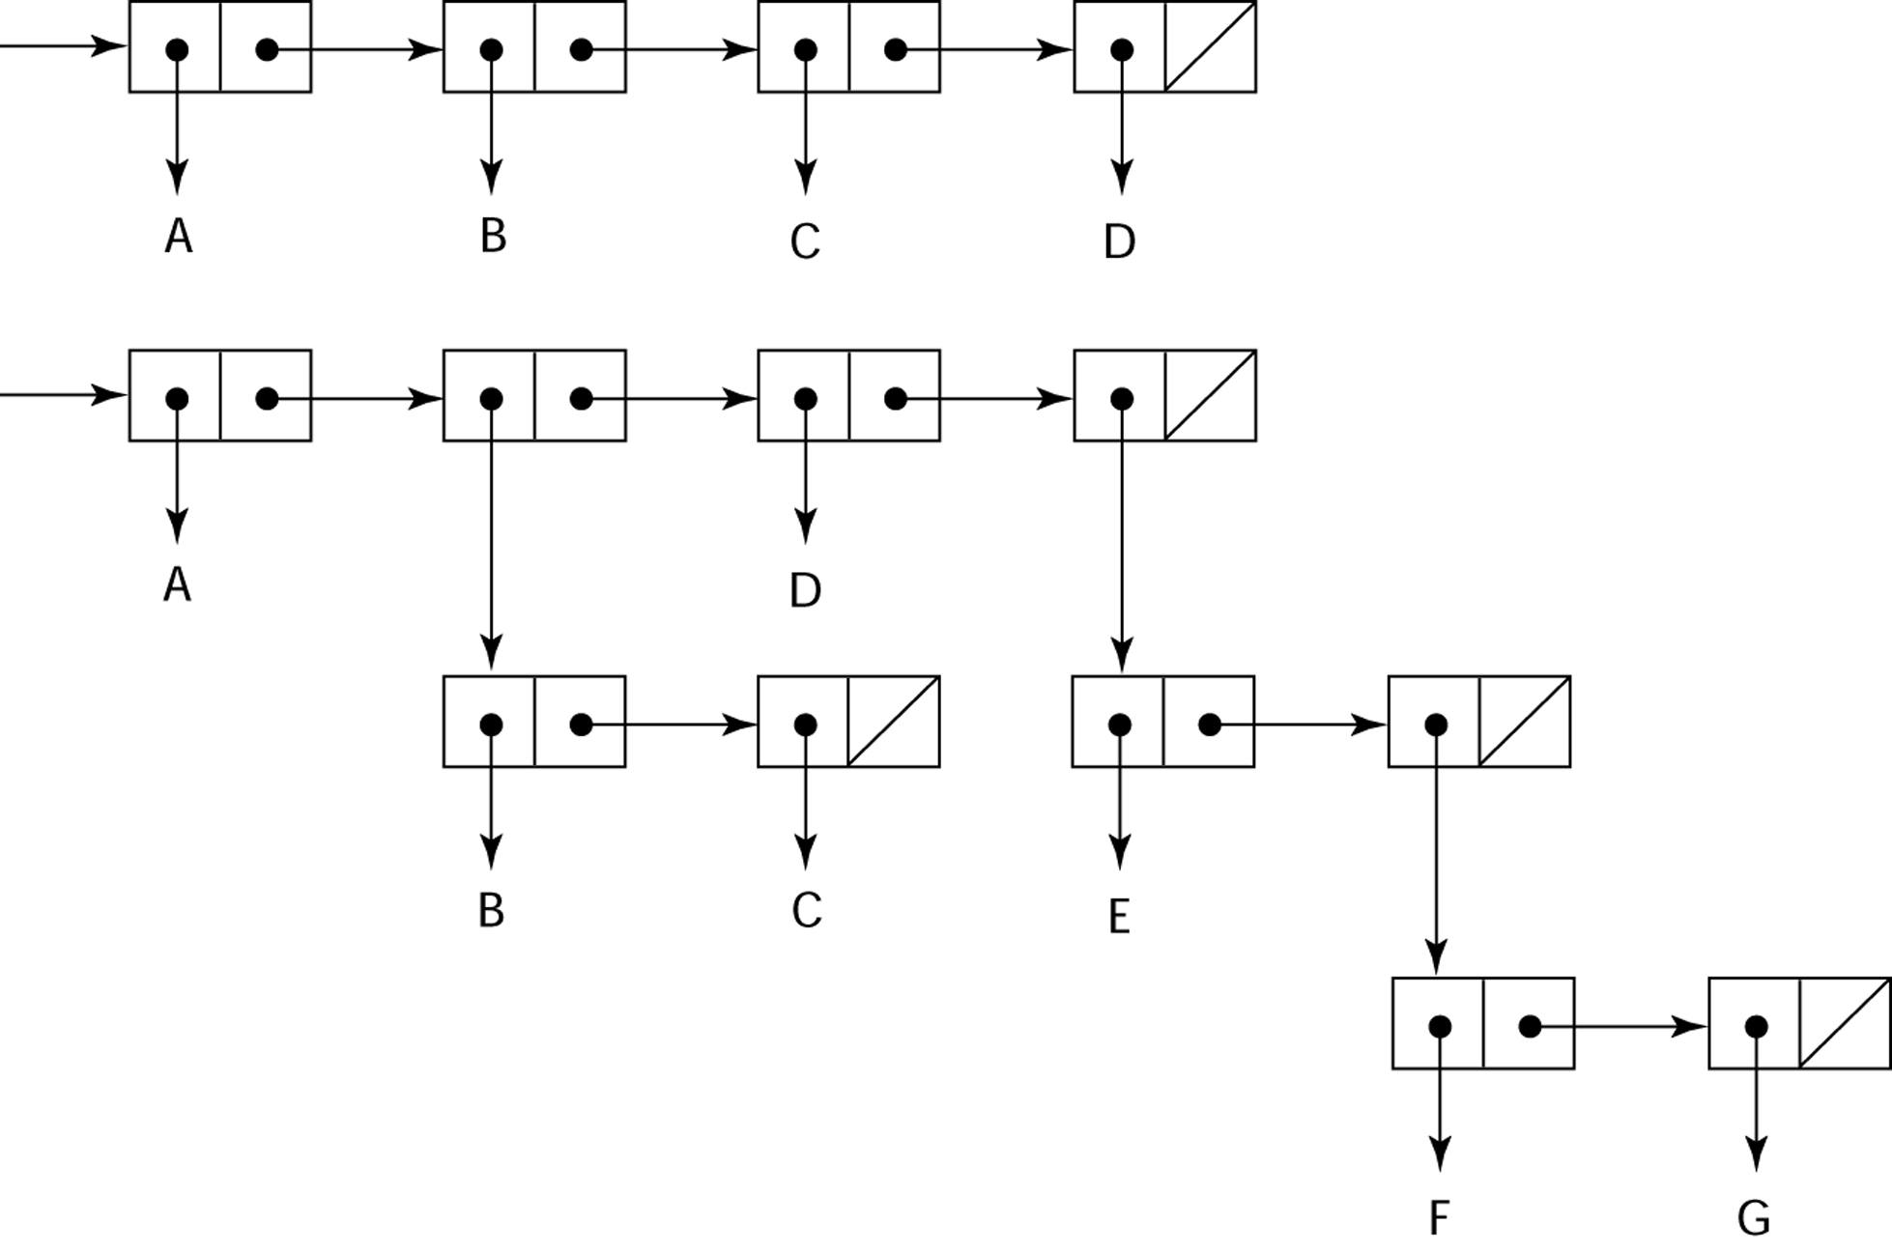
Representation of Two LISP Lists

Slide 20
LISP
Pioneered functional programming
  No need for variables or assignment
  Control via recursion and conditional expressions
Still the dominant language for AI
COMMON LISP and Scheme are contemporary dialects of LISP
ML, Miranda, and Haskell are related languages

Slide 21
ALGOL 58 and 60
Environment of development:
  FORTRAN had (barely) arrived for IBM 70x
  Many other languages were being developed, all for specific machines
  No portable language; all were machine- dependent
  No universal language for communicating algorithms

Slide 22
ALGOL 58 and 60
ACM and GAMM met for four days for design
Goals of the language:
  Close to mathematical notation
  Good for describing algorithms
  Must be translatable to machine code

Slide 23
ALGOL 58 and 60
ALGOL 58 Language Features:
  Concept of type was formalized
  Names could have any length
  Arrays could have any number of subscripts
  Parameters were separated by mode (in & out)
  Subscripts were placed in brackets
  Compound statements (begin ... end)
  Semicolon as a statement separator
  Assignment operator was :=
  if had an else-if clause
  No I/O - “would make it machine dependent”

Slide 24
ALGOL 58
Comments:
  Not meant to be implemented, but variations of it were (MAD, JOVIAL)
  Although IBM was initially enthusiastic, all support was dropped by mid-1959

Slide 25
ALGOL 58 and 60
ALGOL 60
  Modified ALGOL 58 at 6-day meeting in Paris
  New features:
    Block structure (local scope)
    Two parameter passing methods
    Subprogram recursion
    Stack-dynamic arrays
    Still no I/O and no string handling

Slide 26
ALGOL 60
Successes:
  It was the standard way to publish algorithms for over 20 years
  All subsequent imperative languages are based on it
  First machine-independent language
  First language whose syntax was formally defined (BNF)

Slide 27
ALGOL 60
Failure:
  Never widely used, especially in U.S.
Reasons:
  No I/O and the character set made programs non-portable
  Too flexible--hard to implement
  Entrenchment of FORTRAN
  Formal syntax description
  Lack of support of IBM

Slide 28
COBOL - 1960
Environment of development:
  UNIVAC was beginning to use FLOW-MATIC
  USAF was beginning to use AIMACO
  IBM was developing COMTRAN

Slide 29
COBOL
Based on FLOW-MATIC
FLOW-MATIC features:
  Names up to 12 characters, with embedded hyphens
  English names for arithmetic operators (no arithmetic expressions)
  Data and code were completely separate
  Verbs were first word in every statement

Slide 30
COBOL
First Design Meeting (Pentagon) - May 1959
Design goals:
  Must look like simple English
  Must be easy to use, even if that means it will be less powerful
  Must broaden the base of computer users
  Must not be biased by current compiler problems
Design committee members were all from computer manufacturers and DoD branches
Design Problems: arithmetic expressions? subscripts? Fights among manufacturers

Slide 31
COBOL
Contributions:
  First macro facility in a high-level language
  Hierarchical data structures (records)
  Nested selection statements
  Long names (up to 30 characters), with hyphens
  Separate data division

Slide 32
COBOL
Comments:
  First language required by DoD; would have failed without DoD
  Still the most widely used business applications language

Slide 33
BASIC - 1964
Designed by Kemeny & Kurtz at Dartmouth
Design Goals:
  Easy to learn and use for non-science students
  Must be “pleasant and friendly”
  Fast turnaround for homework
  Free and private access
  User time is more important than computer time
Current popular dialect: Visual BASIC
First widely used language with time sharing

Slide 34
PL/I - 1965
Designed by IBM and SHARE
Computing situation in 1964 (IBM's point of view)
  Scientific computing
    IBM 1620 and 7090 computers
    FORTRAN
    SHARE user group
  Business computing
    IBM 1401, 7080 computers
    COBOL
    GUIDE user group

Slide 35
PL/I
By 1963, however,
  Scientific users began to need more elaborate I/O, like COBOL had; Business users began to need floating point and arrays (MIS)
  It looked like many shops would begin to need two kinds of computers, languages, and support staff--too costly
The obvious solution:
  Build a new computer to do both kinds of applications
  Design a new language to do both kinds of applications

Slide 36
PL/I
Designed in five months by the 3 X 3 Committee
PL/I contributions:
  First unit-level concurrency
  First exception handling
  Switch-selectable recursion
  First pointer data type
  First array cross sections

Slide 37
PL/I
Comments:
  Many new features were poorly designed
  Too large and too complex
  Was (and still is) actually used for both scientific and business applications

Slide 38
APL and SNOBOL
Characterized by dynamic typing and dynamic storage allocation
APL (A Programming Language) 1962
  Designed as a hardware description language (at IBM by Ken Iverson)
  Highly expressive (many operators, for both scalars and arrays of various dimensions)
  Programs are very difficult to read

Slide 39
APL and SNOBOL
SNOBOL(1964)
  Designed as a string manipulation language (at Bell Labs by Farber, Griswold, and Polensky)
  Powerful operators for string pattern matching

Slide 40
SIMULA 67 - 1967
Designed primarily for system simulation (in Norway by Nygaard and Dahl)
Based on ALGOL 60 and SIMULA I
Primary Contribution:
  Co-routines - a kind of subprogram
  Implemented in a structure called a class
  Classes are the basis for data abstraction
  Classes are structures that include both local data and functionality
  Objects and inheritance

Slide 41
ALGOL 68 - 1968
From the continued development of ALGOL 60, but it is not a superset of that language
Design is based on the concept of orthogonality
Contributions:
  User-defined data structures
  Reference types
  Dynamic arrays (called flex arrays)

Slide 42
ALGOL 68
Comments:
  Had even less usage than ALGOL 60
  Had strong influence on subsequent languages, especially Pascal, C, and Ada

Slide 43
Important ALGOL Descendants
Pascal - 1971
  Designed by Wirth, who quit the ALGOL 68 committee (didn't like the direction of that work)
  Designed for teaching structured programming
  Small, simple, nothing really new
  From mid-1970s until the late 1990s, it was the most widely used language for teaching programming in colleges

Slide 44
Important ALGOL Descendants
C - 1972
  Designed for systems programming (at Bell Labs by Dennis Richie)
  Evolved primarily from B, but also ALGOL 68
  Powerful set of operators, but poor type checking
  Initially spread through UNIX

Slide 45
Important ALGOL Descendants
Modula-2 - mid-1970s (Wirth)
  Pascal plus modules and some low-level features designed for systems programming
Modula-3 - late 1980s (Digital & Olivetti)
  Modula-2 plus classes, exception handling, garbage collection, and concurrency

Slide 46
Important ALGOL Descendants
Oberon - late 1980s (Wirth)
  Adds support for OOP to Modula-2
  Many Modula-2 features were deleted (e.g., for statement, enumeration types, with statement, noninteger array indices)

Slide 47
Prolog - 1972
Developed at the University of Aix-Marseille, by Comerauer and Roussel, with some help from Kowalski at the University of Edinburgh
Based on formal logic
Non-procedural
Can be summarized as being an intelligent database system that uses an inferencing process to infer the truth of given queries

Slide 48
Ada - 1983 (began in mid-1970s)
Huge design effort, involving hundreds of people, much money, and about eight years
Environment: More than 450 different languages being used for DOD embedded systems (no software reuse and no development tools)
Contributions:
  Packages - support for data abstraction
  Exception handling - elaborate
  Generic program units
  Concurrency - through the tasking model

Slide 49
Ada
Comments:
  Competitive design
  Included all that was then known about software engineering and language design
  First compilers were very difficult; the first really usable compiler came nearly five years after the language design was completed

Slide 50
Ada
Ada 95 (began in 1988)
  Support for OOP through type derivation
  Better control mechanisms for shared data (new concurrency features)
  More flexible libraries

Slide 51
Smalltalk - 1972-1980
Developed at Xerox PARC, initially by Alan Kay, later by Adele Goldberg
First full implementation of an object-oriented language (data abstraction, inheritance, and dynamic type binding)
Pioneered the graphical user interface everyone now uses

Slide 52
C++ - 1985
Developed at Bell Labs by Stroustrup
Evolved from C and SIMULA 67
Facilities for object-oriented programming, taken partially from SIMULA 67, were added to C
Also has exception handling
A large and complex language, in part because it supports both procedural and OO programming
Rapidly grew in popularity, along with OOP
ANSI standard approved in November, 1997

Slide 53
C++ Related Languages
Eiffel - a related language that supports OOP
  (Designed by Bertrand Meyer - 1992)
  Not directly derived from any other language
  Smaller and simpler than C++, but still has most of the power
Delphi (Borland)
  Pascal plus features to support OOP
  More elegant and safer than C++

Slide 54
Java (1995)
Developed at Sun in the early 1990s
Based on C++
  Significantly simplified (does not include struct, union, enum, pointer arithmetic, and half of the assignment coercions of C++)
  Supports only OOP
  Has references, but not pointers
  Includes support for applets and a form of concurrency

Slide 55
Scripting Languages for the Web
JavaScript
  Used in Web programming (client-side) to create dynamic HTML documents
  Related to Java only through similar syntax
PHP
  Used for Web applications (server-side); produces HTML code as output

Slide 56
C#
Part of the .NET development platform
Based on C++ and Java
Provides a language for component-based software development
All .NET languages (C#, Visual BASIC.NET, Managed C++, J#.NET, and Jscript.NET) use Common Type System (CTS), which provides a common class library
Likely to become widely used

